Slide 1
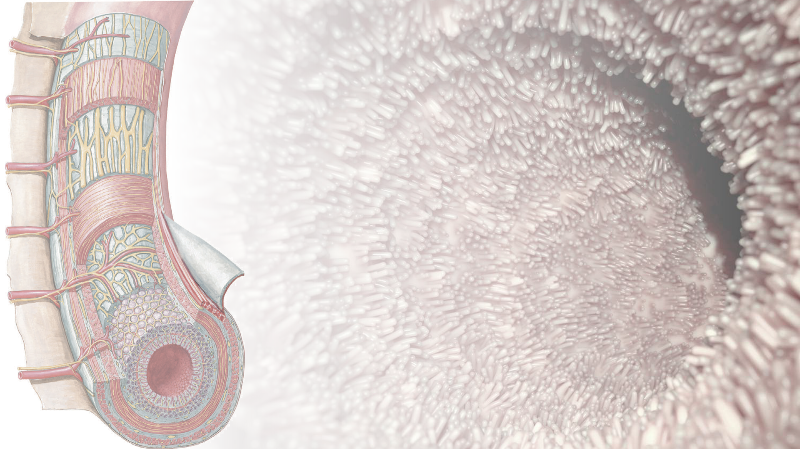
Chronic Diarrhea
Focus: Small Bowel
Mohammad Almeqdadi, MD

Slide 2
Outline
Definitions
Classification
Pathophysiology
Clinical evaluation and work u
Specific small bowel diseases
Treatment

Slide 3
Normal Bowel Movements
Who has diarrhea and who has constipation?
4-5 BMs per day
3 BMs per day
2 BMs per day
1-2 BM per day
1 BM every 2 days
1 BM every 3 days
1 BM every 5 days

Slide 4
Normal Bowel Movements
Who has diarrhea and who has constipation?
4-5 BMs per day
3 BMs per day
2 BMs per day
1-2 BM per day
1 BM every 2 days
1 BM every 3 days
1 BM every 5 days
Diarrhea
Normal
Constipation

Slide 5
What is diarrhea?

Slide 6
What is diarrhea?
Diarrhea as defined by patients is increased liquidity of stool
Clinical definitions
More than three bowel movements per day
OR
More than 200 g of stool per day
Can be up to 300 g in patients who take fiber supplements
Should also be aware of incontinence which needs to be evaluated separately

Slide 7
Clinical classification of diarrhea
Class | Examples
Duration of illness | Acute vs chronic
Stool characteristic | Watery, fatty, or bloody
Pathophysiology | Osmotic, secretory or inflammatory
Population at risk | AIDS, international travelers, etc.
Severity | Large vs small volume

Slide 8
Pathophysiology of diarrhea

Slide 9
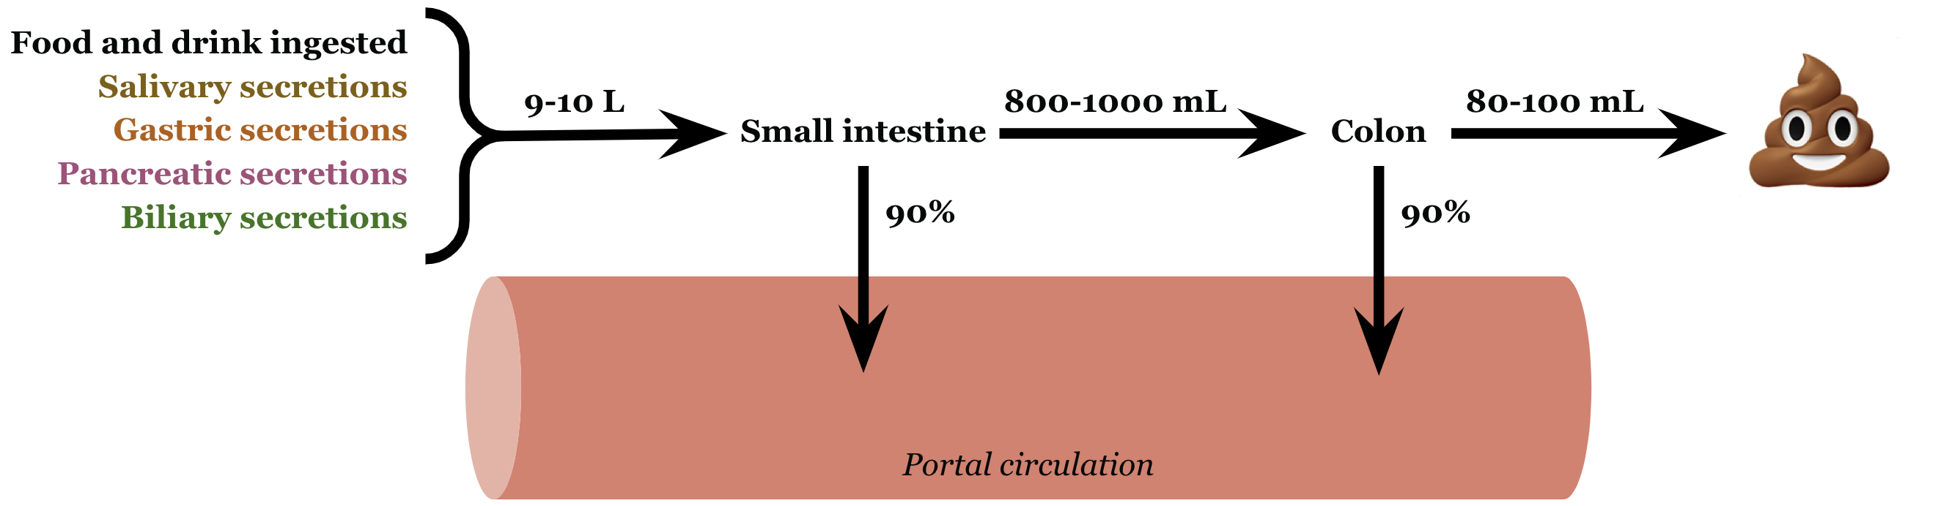
Pathophysiology of diarrhea

Slide 10
Pathophysiology of diarrhea
A decrease in overall intestinal absorption of 1-2% is sufficiency to cause diarrhea

Slide 11
Pathophysiology of diarrhea
A decrease in overall intestinal absorption of 1-2% is sufficiency to cause diarrhea
What type of diarrhea is this?

Slide 12
Pathophysiology of diarrhea
A decrease in overall intestinal absorption of 1-2% is sufficiency to cause diarrhea
Secretory diarrhea

Slide 13
Pathophysiology of diarrhea
A decrease in overall intestinal absorption of 1-2% is sufficiency to cause secretory diarrhea
Excess stool water from poorly absorbed substances that remain in the lumen can cause osmotic diarrhea

Slide 14
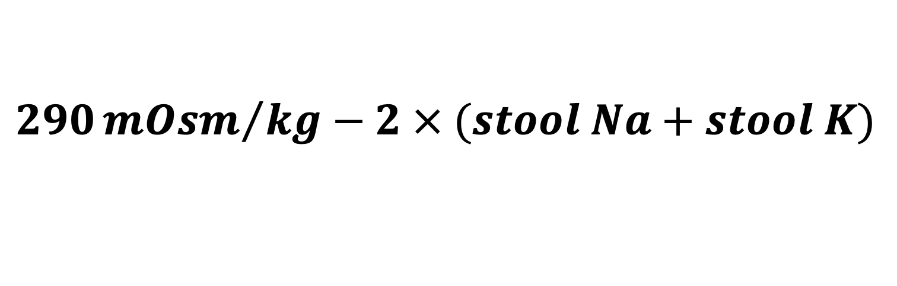
Fecal osmotic gap
$$290{mOsm}/{kg}−2 × (stool Na+stool K)$$

Slide 15
Fecal osmotic gap
$$290{mOsm}/{kg}−2 × (stool Na+stool K)$$
 | Osmotic Diarrhea | Secretory Diarrhea
Osmotic Gap | < 50 | > 100-125
Stool pH | > 6.0 | < 5.5

Slide 16
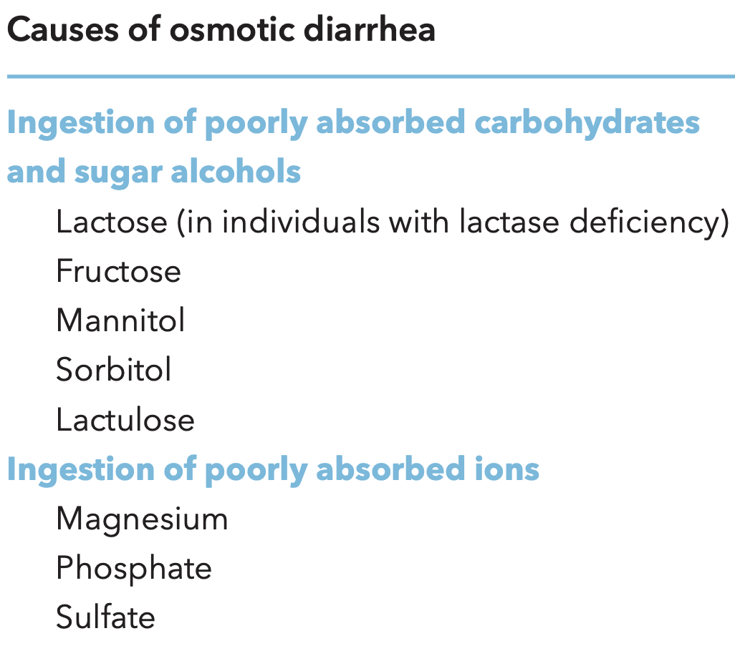
Osmotic diarrhea
Excess stool water can result from ingestion of poorly absorbed substances that remain in the lumen of the intestine and obligate retention of water within the lumen by virtue of their osmotic effects
Electrolyte absorption is unaffected by these osmotically active substances and stool water contains very little unabsorbed sodium or potassium with osmotic diarrhea

Slide 17
Secretory diarrhea
When the osmotic gap is small, electrolytes account for most of the luminal osmolality
Secretory diarrhea is somewhat of a misnomer: most patients with secretory diarrhea, as defined by a small osmotic gap, still absorb most of the nine to 10 L of fluid entering the jejunum each day; they just do not absorb almost all of it
Several mechanisms can lead to secretory diarrhea

Slide 18
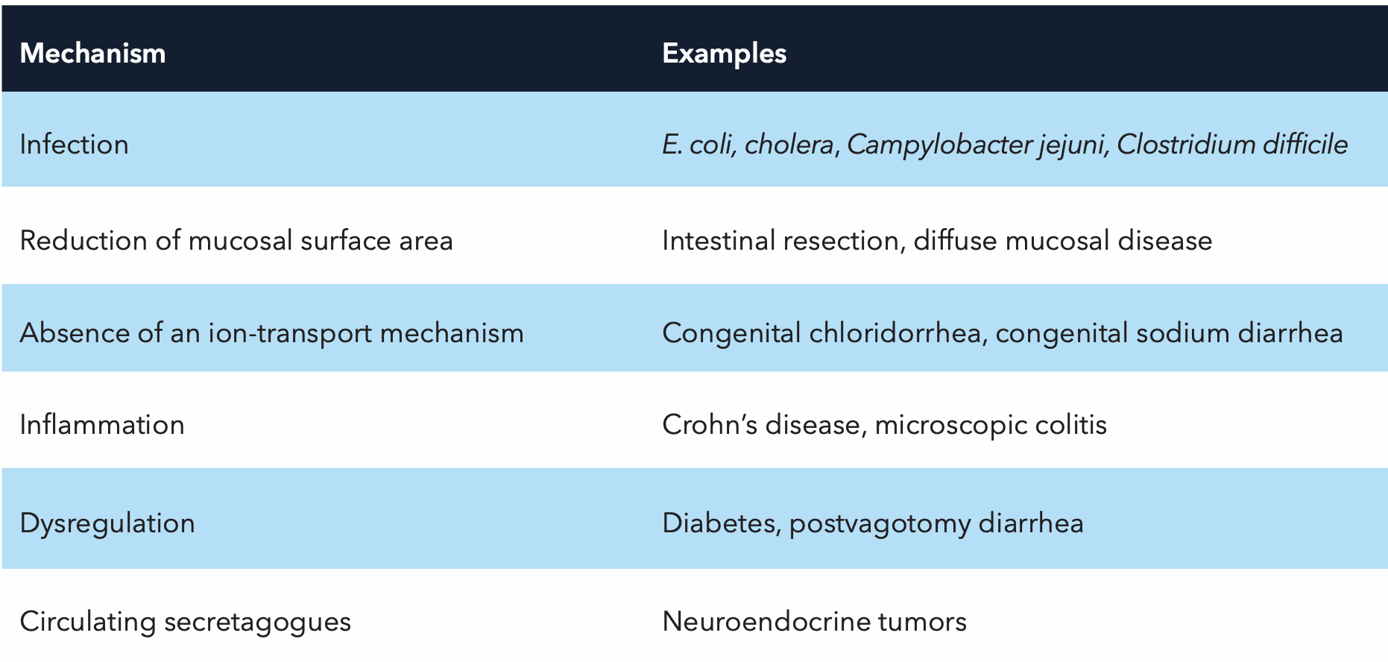
Secretory diarrhea

Slide 19
Infections
Usually cause acute diarrhea, however chronic infections exist especially in immunocompromised patients
Diarrhea is secretory due to either direct bacterial invasion, enterocyte destruction or toxin production

Slide 20
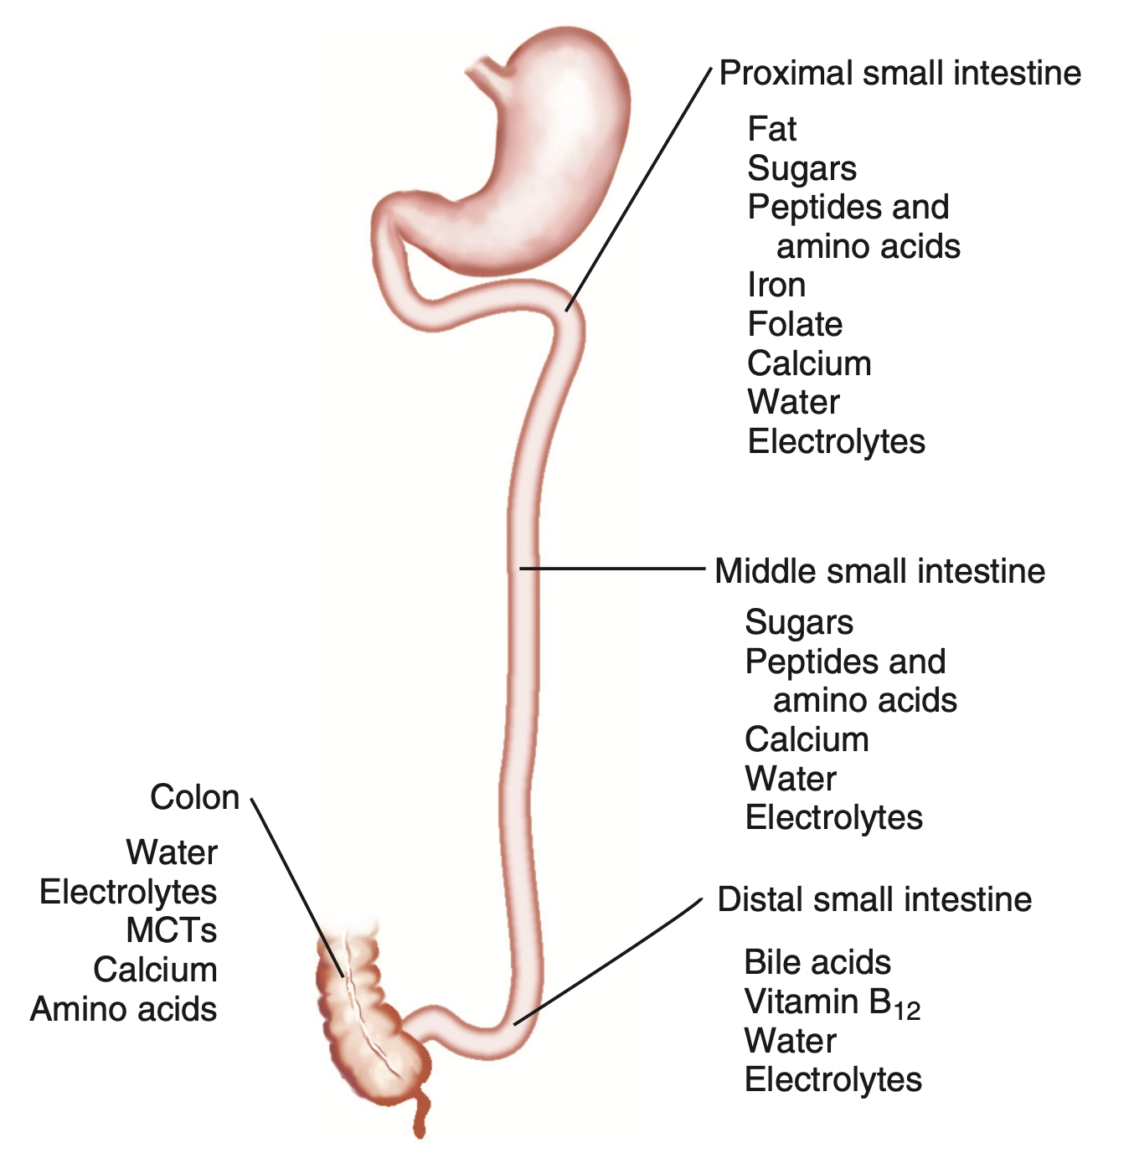
Reduction of mucosal surface area
Absorptive function in different parts of the intestine is specialized, some segments cannot compensate for the missing functions of other segments
There must be enough reserve capacity more distally to be able to compensate for missing absorptive function

Slide 21
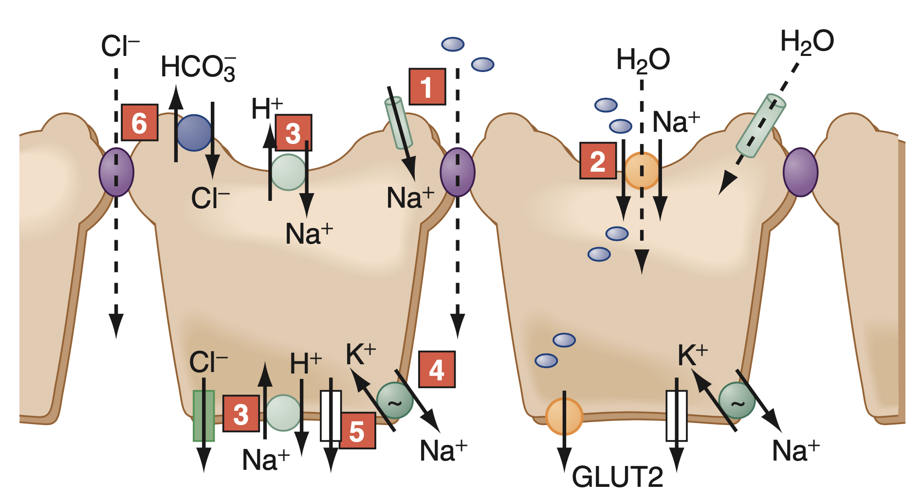
Absence of ion transport mechanism
Usually, congenital absence of transporters that can cause secretory diarrhea due to absence of specific ion transporters such as Cl-HCO3 transporter or Na-H antiporter.

Slide 22
Inflammation
The immune system in the intestine modulates electrolyte absorption by release of cytokines and by effects on the enteric nervous system

Slide 23
Dysregulation
Secretory diarrhea may occur as a complication of diabetic autonomic neuropathy.
Abnormal function of the enteric nervous system may alter the dynamics of intestinal fluid and electrolyte absorption or motility.
Similar difficulties may occur in patients who develop diarrhea after vagotomy, sympathectomy, or celiac plexus neurolysis

Slide 24
Circulating secretagogues
Tumors of endocrine cells in the gut, pancreas, and elsewhere can produce high enough circulating levels of secretagogues that inhibit absorption or increase secretions in the intestine
Rarely the cause as estimates of prevalence range from 1/1000-10,000 patients with chronic diarrhea

Slide 25
Evaluating a patient with diarrhea

Slide 26
History
Taking a thorough history is the most important step in management
Duration of diarrhea (4 weeks as the cut off for acute vs chronic)
Frequency of BMs, does not correlate with stool weight necessarily
Assess hydration status by asking about thirst, decreased urine output, and weakness
Acute weight loss = severe diarrhea
Stool characteristics
  blood, mucus, pus, oil droplets, or food particles

Slide 27
History
Relationship of defecation to meals or fasting

Slide 28
History
Relationship of defecation to meals or fasting
What is the significance of diarrhea relation to fasting?

Slide 29
History
Relationship of defecation to meals or fasting
What is the significance of diarrhea relation to fasting?
Osmotic diarrhea usually resolves with fasting

Slide 30
History
Relationship of defecation to meals or fasting – can differentiate osmotic
Passage of stool during the day versus the night
What’s the significance of having nocturnal symptoms?

Slide 31
History
Relationship of defecation to meals or fasting – can differentiate osmotic
Passage of stool during the day versus the night
  Night symptoms suggest an organic cause rather than a functional problem

Slide 32
History
Relationship of defecation to meals or fasting – can differentiate osmotic
Passage of stool during the day versus the night
  Night symptoms suggest an organic cause rather than a functional problem
Be aware! urgency and incontinence reflect a rectal problem rather than severe diarrhea
Associated symptoms: abdominal pain, flatulence, bloating, or gaseous distention, cramps, fever, and weight loss
Explore patient’s diet in detail (breakfast, lunch, dinner, snacks, etc.)
  Check for FODMAPs!

Slide 33
History
What kind of diarrhea do FODMAPs cause?

Slide 34
History
What kind of diarrhea do FODMAPs cause?
Osmotic diarrhea

Slide 35
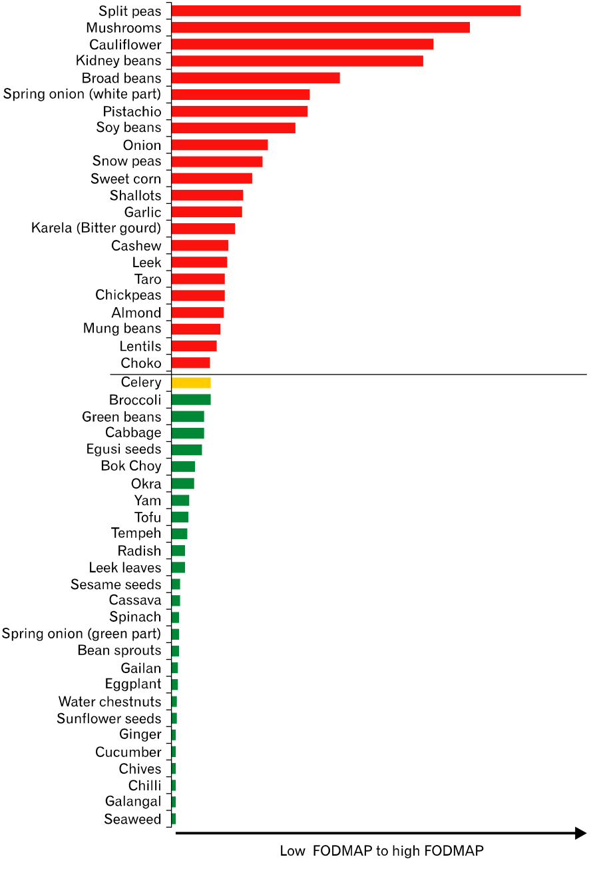
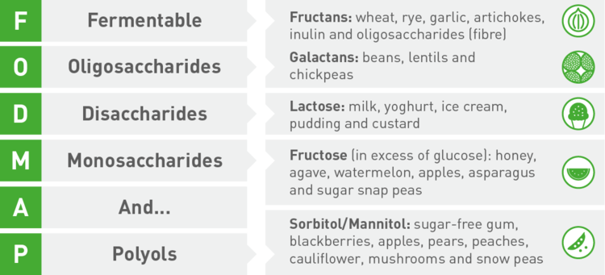
FODMAPs
DOI: 10.5056/jnm15111

Slide 36
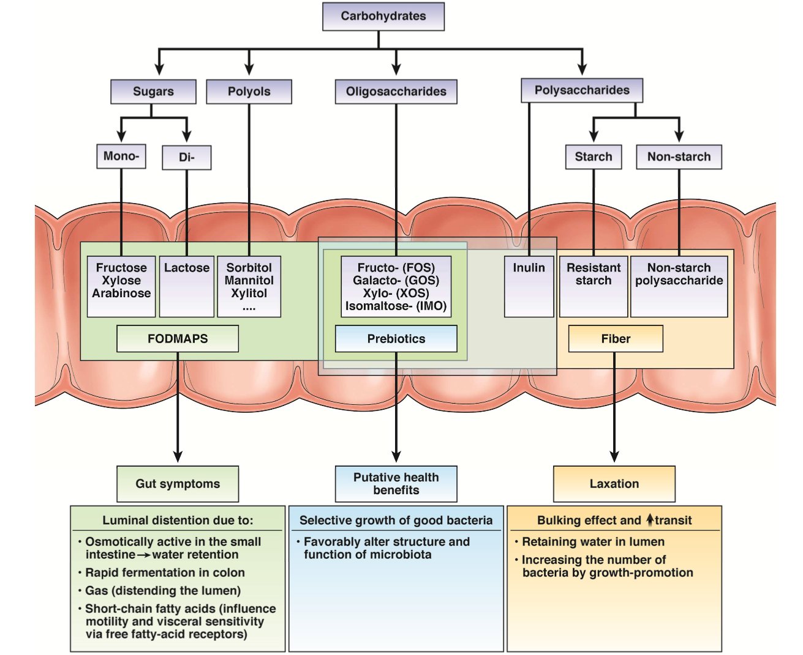
http://dx.doi.org/10.1053/j.gastro.2015.02.005

Slide 37
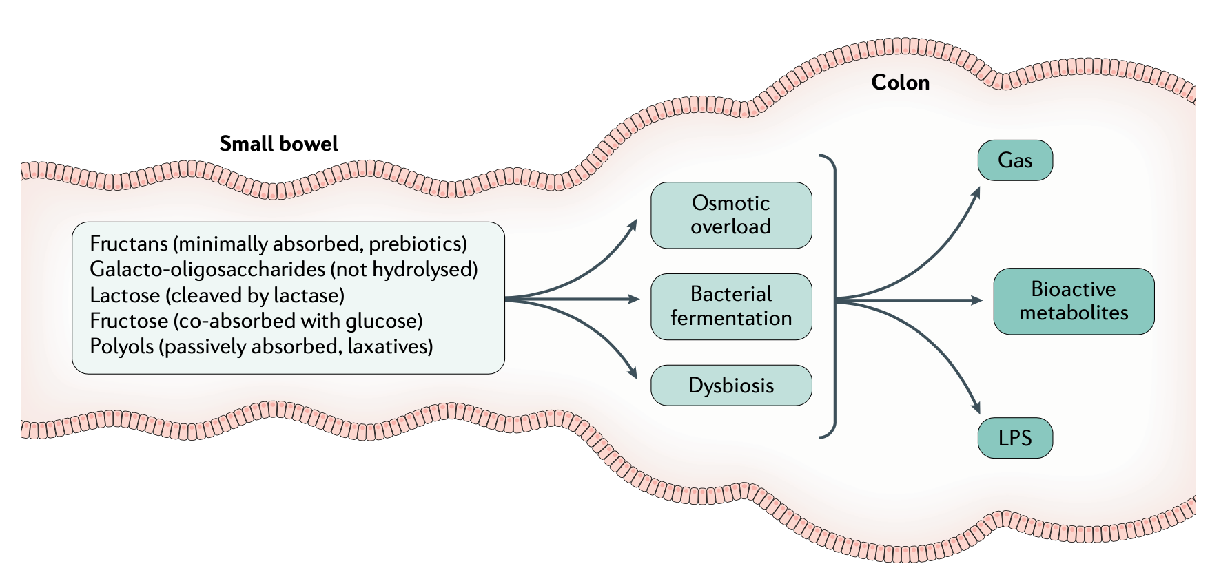
FODMAPs
https://doi.org/10.1038/ s41575-020-0270-3

Slide 38
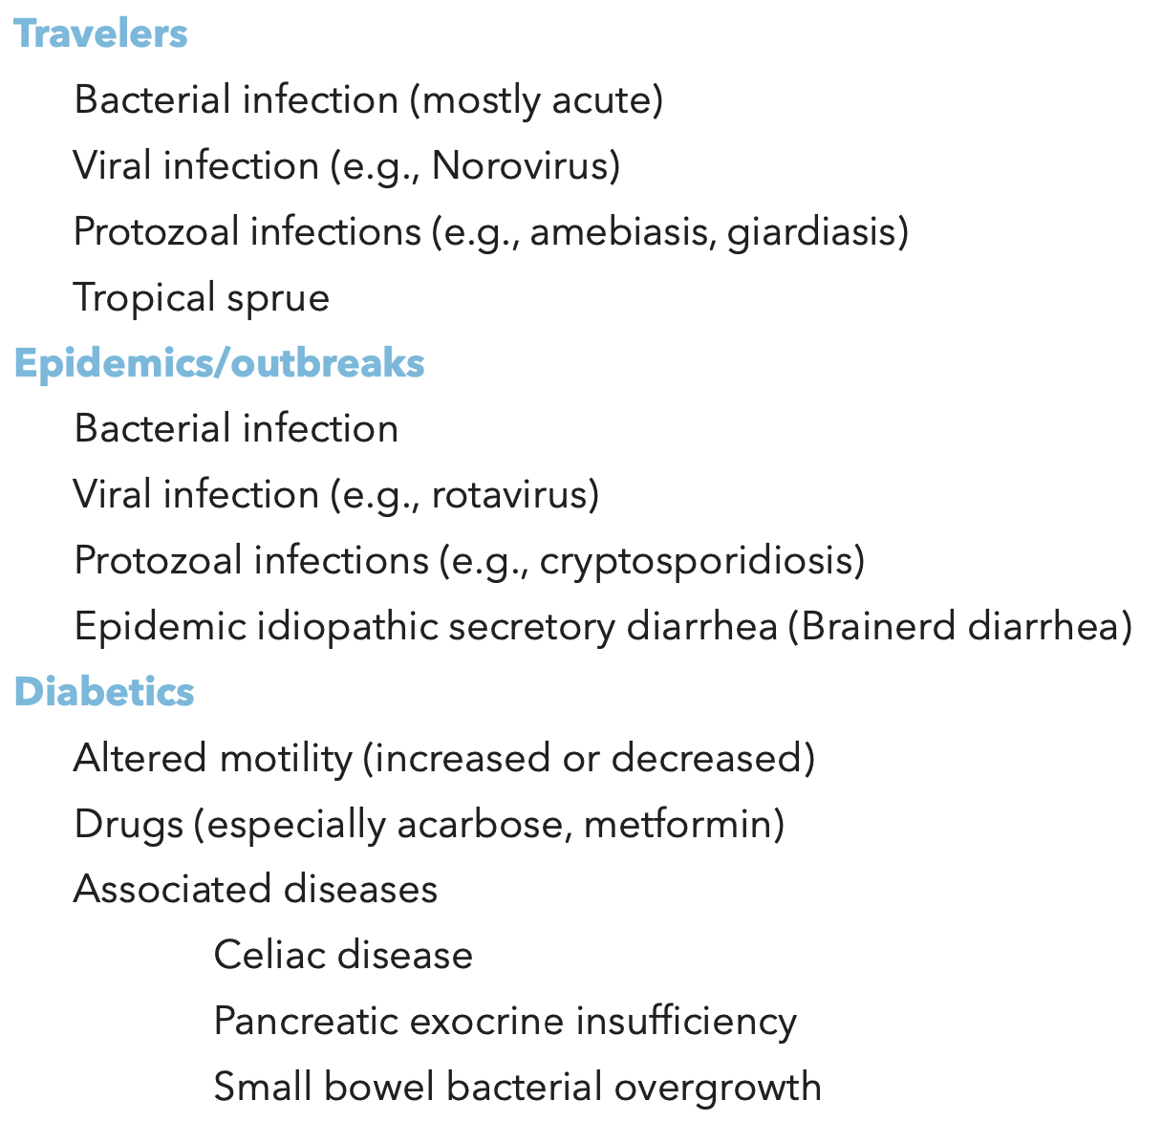
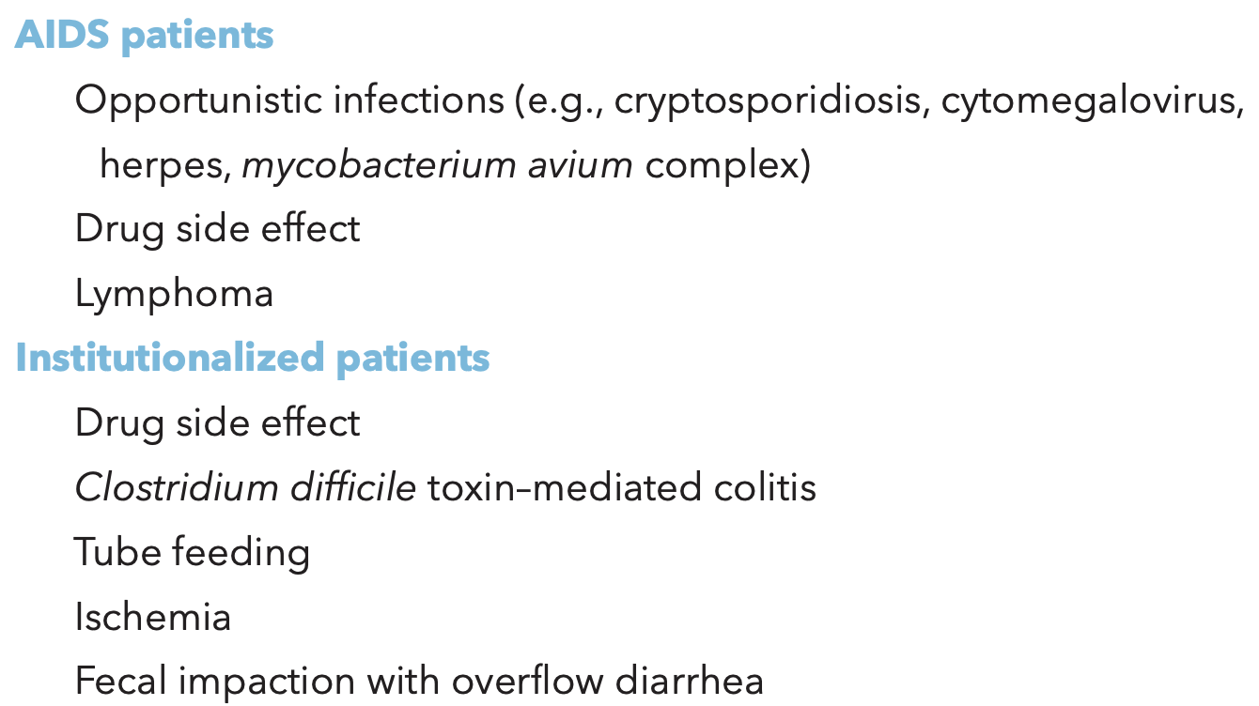
History
Ask about specific risk factors (medical/epidemiologic/etc.)

Slide 39
History
Place of residence (rural vs city) as may affect source of drinking water
Explore the patient’s occupation, sexual preference and activity, exposure to farm or pet animals, and use of illicit drugs or alcohol
Always consider potential secondary gains from illness or a history of attempted weight loss or fixation on body image should raise the possibility of laxative abuse

Slide 40
Physical examination
Physical signs are more helpful to determine the severity of diarrhea, rather than its cause
Assess volume status!
  orthostatic changes in blood pressure and pulse
Abdominal exam including auscultating for bowel sounds
  Frequency
  Intensity
  Location
  Pitch
  Pattern

Slide 41
Physical examination
Physical signs are more helpful to determine the severity of diarrhea, rather than its cause
Assess volume status!
  orthostatic changes in blood pressure and pulse
Abdominal exam including auscultating for bowel sounds
  Frequency– What’s normal frequency?
  Intensity
  Location
  Pitch
  Pattern

Slide 42
Physical examination
Physical signs are more helpful to determine the severity of diarrhea, rather than its cause
Assess volume status!
  orthostatic changes in blood pressure and pulse
Abdominal exam including auscultating for bowel sounds
  Frequency– 5-34/minute
  Intensity
  Location
  Pitch
  Pattern
Assess the presence or absence of abdominal distention and tenderness

Slide 43
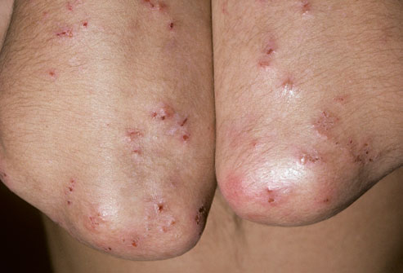
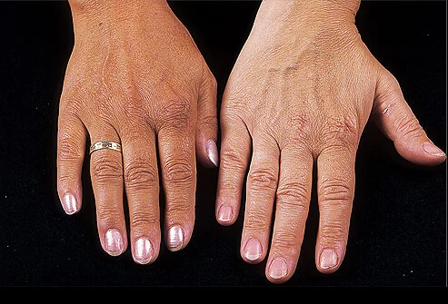
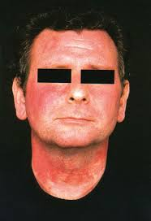
Physical examination
On rare occasions, the physical examination may provide more direct evidence of the cause of diarrhea such as characteristic rashes

Slide 44
Physical examination
On rare occasions, the physical examination may provide more direct evidence of the cause of diarrhea such as characteristic rashes
Dermatitis herpetiform
Celiac disease
Hyperpigmentation
Addison’s disease
Facial flushing
Carcinoid

Slide 45
Physical examination
Palpate the abdomen for organomegaly
  Hepatosplenomegaly can be seen in infiltrative diseases such as amyloidosis
Don’t forget to examine the thyroid, check for nodules and goiter
Auscultate the heart: tricuspid regurgitation could indicate carcinoid

Slide 46
Physical examination
Palpate the abdomen for organomegaly
  Hepatosplenomegaly can be seen in infiltrative diseases such as amyloidosis
Don’t forget to examine the thyroid, check for nodules and goiter
Auscultate the heart: tricuspid regurgitation could indicate carcinoid
Most importantly, don’t forget a digital rectal exam!

Slide 47
Physical examination
Digital rectal exam
Carefully examine the external anal sphincter for any defects
Assess the tone of the anal sphincter during the exam
  Make sure “diarrhea” is not incontinence
Check for any masses or stool impaction
  Can be the cause of overflow diarrhea in bedbound patients

Slide 48
Further evaluation of chronic diarrhea

Slide 49
Further evaluation of chronic diarrhea
CBC, CMP, CRP, IgA anti TTG (and total IgA)
Fecal lactoferrin or leukocytes
Stool culture
Stool C. difficile screen
Ova and parasite exam and fecal antigens
If available, stool multiplex PCR testing
If history, physical exam and lab tests reveal the problem, you can start empiric therapy

Slide 50
Further evaluation of chronic diarrhea
When no diagnosis is suggested by the initial evaluation, the clinician first should consider four possibilities:
Fecal incontinence masquerading as chronic diarrhea
Iatrogenic diarrhea due to drugs, surgery or radiation therapy
Chronic infection
IBS with diarrhea

Slide 51
Chronic watery diarrhea

Slide 52
Chronic watery diarrhea
Secretory diarrhea has a broad differential diagnosis (see next slide)
The common thread among these conditions is that salt and water absorption is impaired
Infection should be excluded (if not previously evaluated) by PCR multiplex assay
Peptide-secreting tumors are very rare, and screening all patients might produce more false positives than true positives
  Test when there is extra-intestinal tumor-related symptoms, such as flushing in carcinoid

Slide 53
BAM!!

Slide 54
Bile acid malabsorption (BAM)

Slide 55
Bile Acid Malabsorption (BAM)
One important differential of chronic diarrhea (bile acid diarrhea – BAD)
Ileal disease or resection allows excessive amounts of conjugated bile acid to enter the colon
If the concentration of bile acid in colon contents exceeds 3–5 mmol/L, electrolyte absorption by the colon mucosa is inhibited and a secretory diarrhea may result
Three distinct types exist
Diagnosis is somewhat controversial

Slide 56
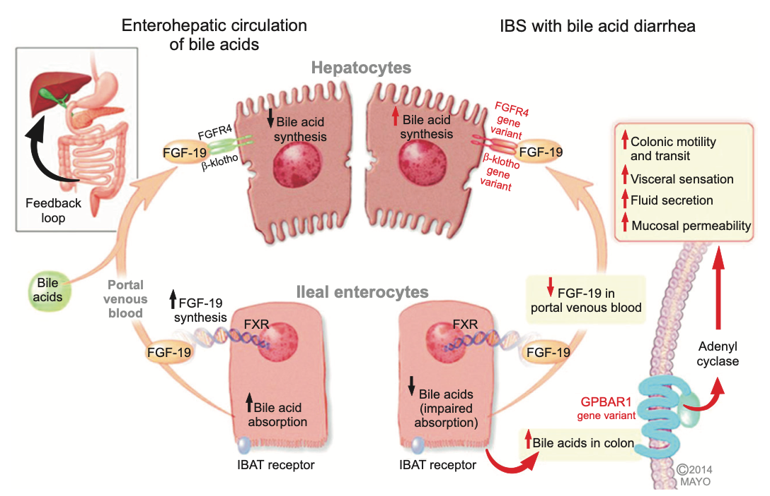
Bile Acid Malabsorption (BAM)
http://dx.doi.org/10.5009/gnl14397
Notes:
Ileal enterocytes absorb bile acid through a receptor-mediated process [ileal bile acid transporter (IBAT)]. Intracellular bile acids activate farnesoid-γ receptor to increase FGF-19 synthesis. FGF-19 in portal circulation downregulates hepatocyte bile acid synthesis. Disorders of FGF-19 synthesis by ileal enterocytes or genetic variations of FGFR4 or β-klotho result in excess bile acid concentration in the colon, resulting in activation of the G-protein coupled bile acid receptor 1 (GPBAR1) with enteroendocrine cell stimulation [(e.g. release of 5-hydroxytryptamine (5-HT)] and stimulation of colonic motility with acceleration of colonic transit, activation of visceral sensation and fluid secretion (through increased intracellular cAMP, increased mucosal permeability or chloride ion secretion). Gene variation in GPBAR1 is associated with increased colonic transit in IBS-D.

Slide 57
Bile Acid Malabsorption (BAM)
Diagnosing BAM can be made in different ways
⁷⁵Selenium homotaurocholic acid seven-day retention test (SeHCAT)
  Validated and used in most European countries, is not available in the USA
Fecal bile acid test
  quantifies individual and total bile acids in a 48-hour stool collection
7α-hydroxy-4-cholesten-3-one (7αC4 or C4 for brief)
  A downstream product of CYP7A1
  Fasting serum C4 levels increase when bile acid synthesis increases, elevated in BAM
  False-positives and false-negatives in patients who have liver disease or are taking statins

Slide 58
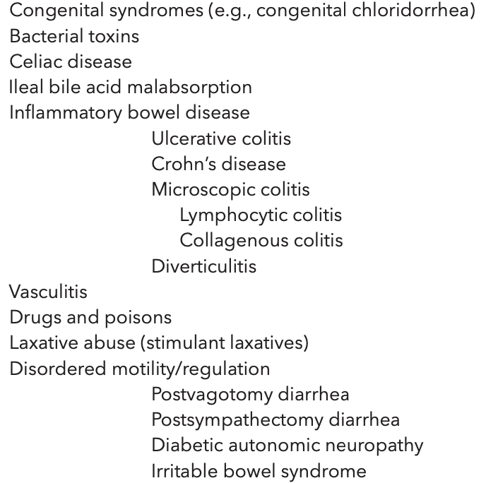
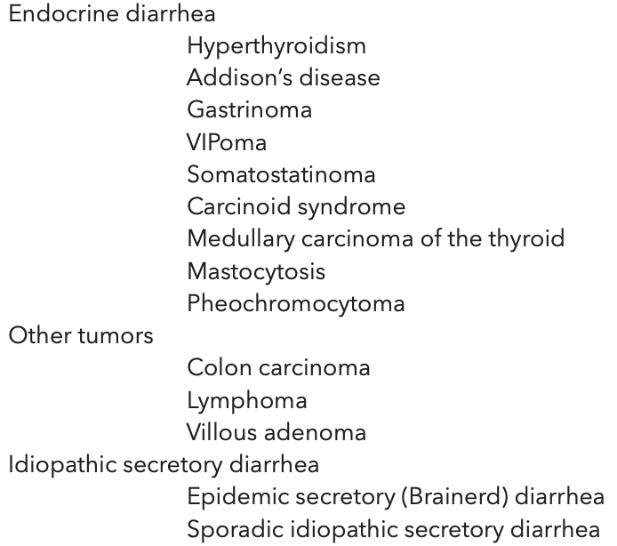
Differentials for Secretory Chronic Diarrhea

Slide 59
Chronic fatty diarrhea

Slide 60
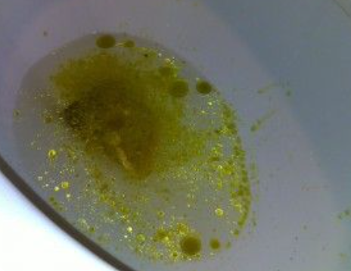

Slide 61
Chronic fatty diarrhea
The presence of steatorrhea implies a disruption of fat solubilization, digestion, or absorption in the small intestine
Fecal fat content can be measured quantitatively, semiquantitatively or qualitatively
Major causes include
  mucosal disease (e.g., celiac disease)
  pancreatic exocrine insufficiency (e.g., chronic pancreatitis)
  lack of bile (e.g., advanced primary biliary cholangitis)

Slide 62
Chronic fatty diarrhea
Initial step would be to measure fecal fat concentration
A fecal fat concentration greater than 9.5 g/100 g strongly suggests the presence of pancreatic or biliary steatorrhea
The cause is usually suspected from the clinical presentation and history
Testing include celiac serologies, upper endoscopy with biopsies, enteroscopy (push, balloon, capsule, etc.) or enterography (CT/MRI) to check for small bowel disease
Testing for exocrine pancreatic insufficiency

Slide 63
Chronic fatty diarrhea
Exocrine pancreatic insufficiency steatorrhea
  Stool chemotrypsin is used in pediatric population, but has limited sensitivity and specificity in patients with chronic diarrhea
  Imaging (CT/MRI/EUS) showing abnormal pancreatic ductal anatomy may provide extra support for the diagnosis
  CCK/Secretin stimulation then endoscopic collection of pancreatic secretion

Slide 64
Chronic fatty diarrhea
Exocrine pancreatic insufficiency steatorrhea
  Stool chemotrypsin is used in pediatric population, but has limited sensitivity and specificity in patients with chronic diarrhea
  Imaging (CT/MRI/EUS) showing abnormal pancreatic ductal anatomy may provide extra support for the diagnosis
  CCK/Secretin stimulation then endoscopic collection of pancreatic secretion
  Fecal elastase-1 can also be used, however false positive (low levels) in watery diarrhea may occur

Slide 65
Chronic fatty diarrhea
Exocrine pancreatic insufficiency steatorrhea
  Stool chemotrypsin is used in pediatric population, but has limited sensitivity and specificity in patients with chronic diarrhea
  Imaging (CT/MRI/EUS) showing abnormal pancreatic ductal anatomy may provide extra support for the diagnosis
  CCK/Secretin stimulation then endoscopic collection of pancreatic secretion
  Fecal elastase-1 can also be used, however false positive (low levels) in watery diarrhea may occur
What is the most available and practical method that is used clinically?

Slide 66
Chronic fatty diarrhea
Exocrine pancreatic insufficiency steatorrhea
  Stool chemotrypsin is used in pediatric population, but has limited sensitivity and specificity in patients with chronic diarrhea
  Imaging (CT/MRI/EUS) showing abnormal pancreatic ductal anatomy may provide extra support for the diagnosis
  CCK/Secretin stimulation then endoscopic collection of pancreatic secretion
  Fecal elastase-1 can also be used, however false positive (low levels) in watery diarrhea may occur
What is the most available and practical method that is used clinically?
Therapeutic trial of pancreatic enzyme supplementation with either symptomatic follow up, or objective measures such as fecal fat excretion

Slide 67
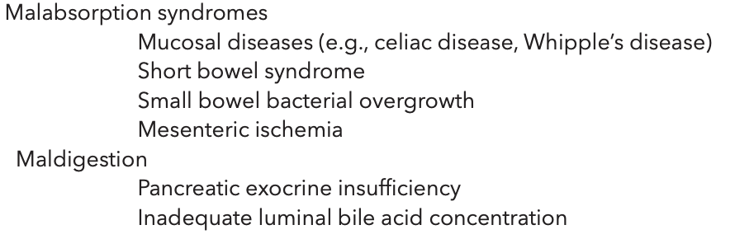
Differentials for Fatty Chronic Diarrhea

Slide 68
Can you just give us an algorithm for chronic diarrhea?

Slide 69
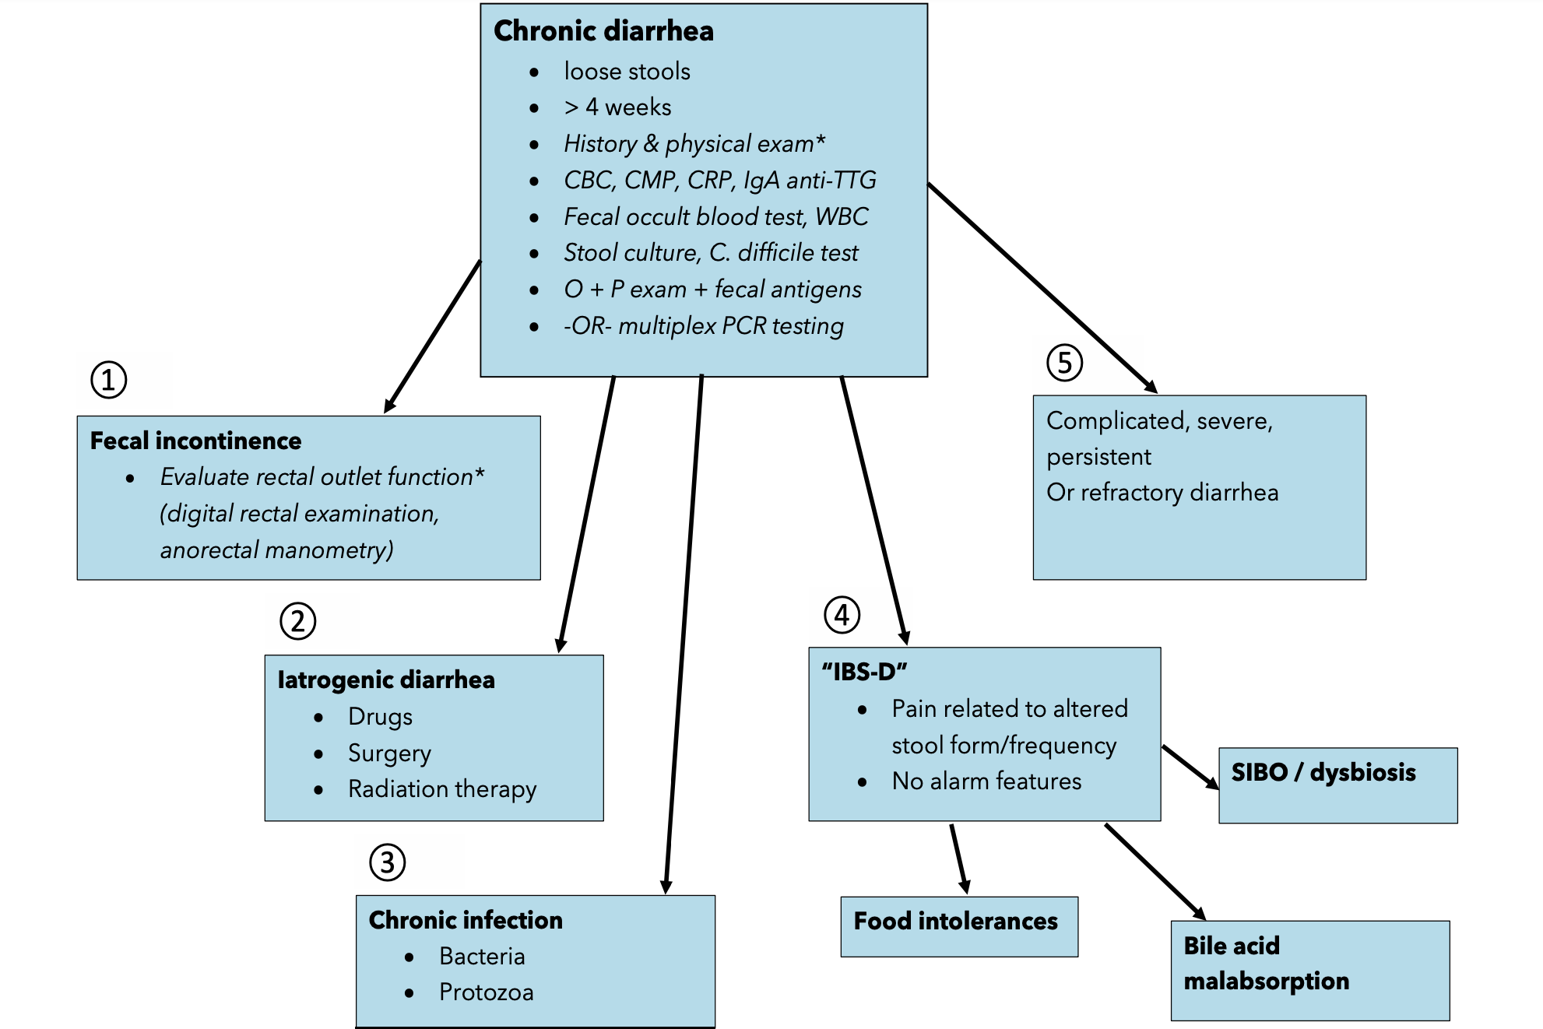
Further evaluation of chronic diarrhea

Slide 70
Further evaluation of chronic diarrhea

Slide 71
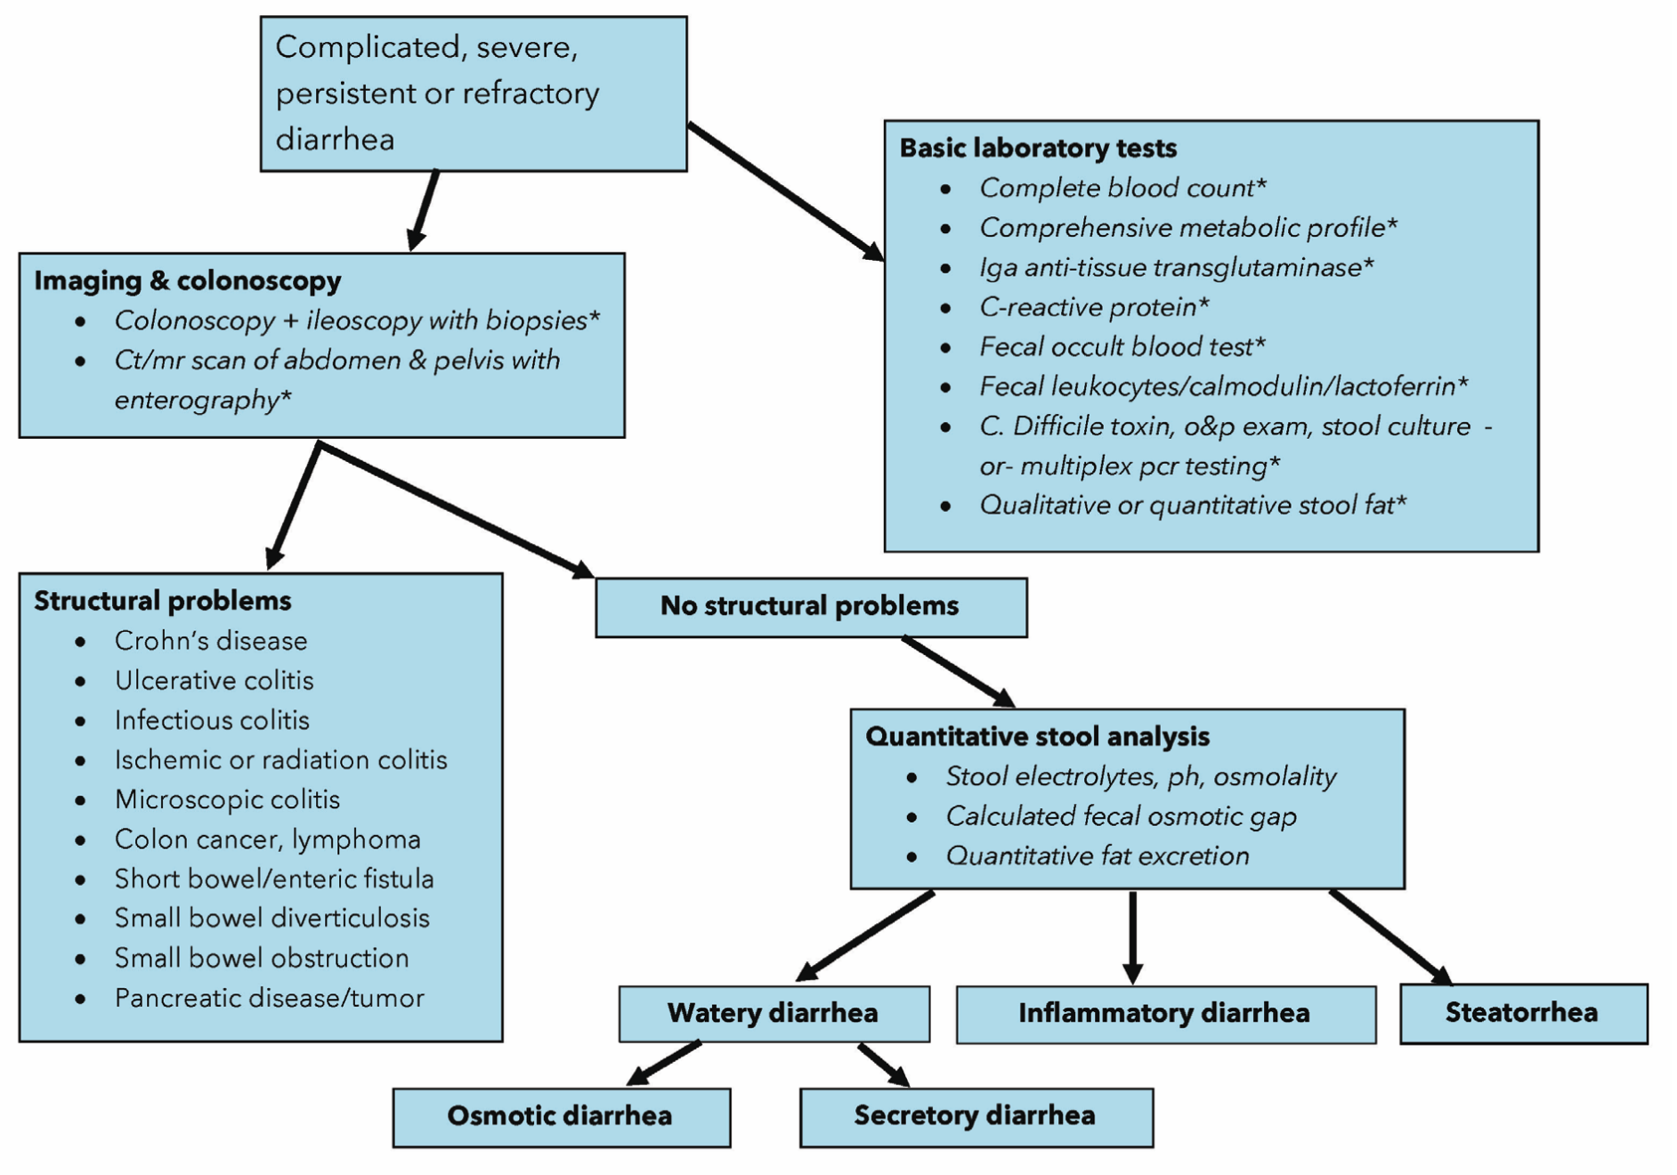
Further evaluation of chronic diarrhea

Slide 72
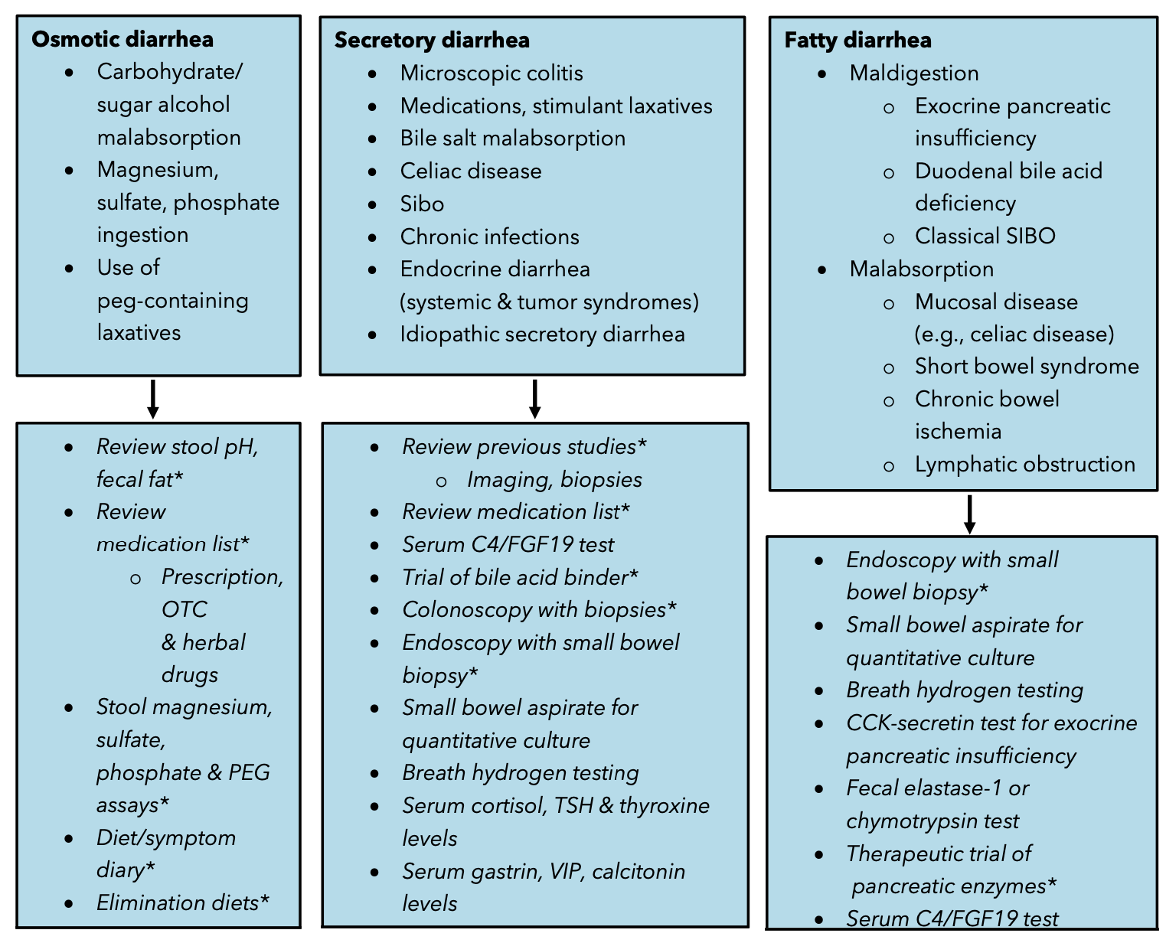
Further evaluation of chronic diarrhea

Slide 73
Specific Small Bowel Diseases

Slide 74
Specific Small Bowel Diseases
Celiac disease
Collagenous sprue
Tropical sprue
Whipple’s disease
Medication-induced enteropathy
Autoimmune enteropathy
Small intestinal bacterial overgrowth (SIBO)
Eosinophilic enteritis
Mastocytosis
Amyloidosis
Lymphangiectasia
Radiation enteritis
Gastrointestinal vasculitis
Ischemic small bowel disease
Short bowel syndrome
GIST

Slide 75
Medication-induced enteropathy

Slide 76
Medication-induced enteropathy
This entity had been increasingly recognized
What medications you should think of when you hear about this?

Slide 77
Medication-induced enteropathy
This entity had been increasingly recognized
What medications you should think of when you hear about this?
NSAIDs
Olmesartan

Slide 78
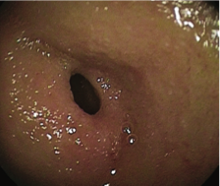
Medication-induced enteropathy
This entity had been increasingly recognized
Can be caused by NSAIDs and ARBs (specifically Olmesartan)
NSAIDs can induce small intestinal ulcers
Olmesartan may produce varying degrees of enteropathy that histologically cause villous atrophy and inflammation
Treatment is to avoid the medication!
NSAID-induced small intestinal diaphragm-like stricture

Slide 79
Autoimmune enteropathy (AIE)

Slide 80
Autoimmune enteropathy (AIE)
Characterized by severe diarrhea, weight loss secondary to malabsorption, villous atrophy
Antibodies include
  Anti-enterocyte antibodies
  Anti-goblet cell antibodies
Typically, a pediatric condition, but may present in adults
Diagnosis of adult AIE can be based on proposed criteria that require endoscopic biopsies

Slide 81
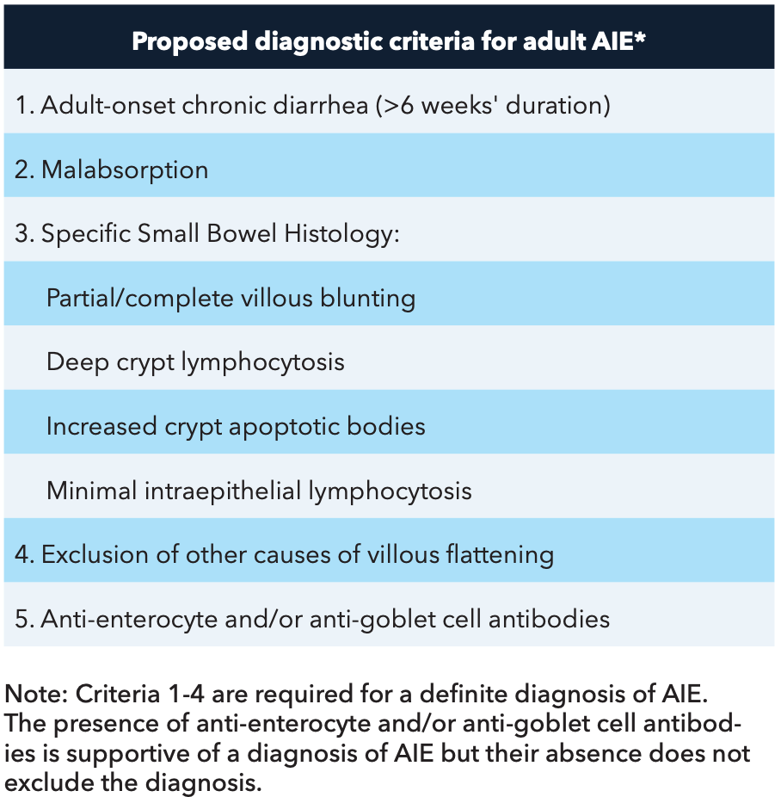
Autoimmune enteropathy (AIE)
Akram et al. Clin Gastroenterol Hepatol. 2007;5:1282-1290

Slide 82
Autoimmune enteropathy (AIE)
AIE can be a part of a multisystem involvement, previously described in scattered case reports
Other associated autoimmune conditions may include atrophic gastritis, autoimmune hepatitis, primary biliary cholangitis, and Sicca syndrome
doi: 10.1016/j.cgh.2007.05.013

Slide 83
Autoimmune enteropathy (AIE)
Treatment is supportive care with adequate hydration and nutritional support
For severe cases corticosteroids (budesonide and prednisone) is typically first line therapy
Steroid-refractory patients, other immunosuppressive agents such as cyclosporine, tacrolimus, mycophenolate mofetil and azathioprine/6-MP have been used successfully

Slide 84
Small intestinal bacterial overgrowth (SIBO)

Slide 85
Small intestinal bacterial overgrowth (SIBO)
Usually occurs when there is abnormal anatomy (i.e. post surgery) or altered motility
Most common etiologies include
  Diabetes
  Celiac disease
  Irritable bowel syndrome
  Scleroderma
  Intestinal diverticulosis
  Afferent loop following a billroth II gastrojejunostomy
  Intestinal obstruction caused by strictures, adhesions, or cancer

Slide 86
Small intestinal bacterial overgrowth (SIBO)
Clinically can present with diarrhea, occasionally constipation, steatorrhea, gas, bloating and abdominal pain with resultant weight loss and anemia
Vitamin deficiency, particularly vitamin B12 deficiency
Why does SIBO cause B12 deficiency?

Slide 87
Small intestinal bacterial overgrowth (SIBO)
Clinically can present with diarrhea, occasionally constipation, steatorrhea, gas, bloating and abdominal pain with resultant weight loss and anemia
Vitamin deficiency, particularly vitamin B12 deficiency
Why does SIBO cause B12 deficiency?
Due to overgrown bacterial metabolism of the vitamin to metabolically ineffective metabolites and internalization of the B12 by the bacteria for their own metabolic uses

Slide 88
Small intestinal bacterial overgrowth (SIBO)
Clinically can present with diarrhea, occasionally constipation, steatorrhea, gas, bloating and abdominal pain with resultant weight loss and anemia
Vitamin deficiency, particularly vitamin B12 deficiency due to bacterial use
Gold standard for diagnosis is obtaining jejunal aspirates
  Jejunal culture > 103 or 105 colony-forming units per milliliter (CFU/ml) of bacteria
Alternative more practical test is hydrogen/methane breath test
  This test is not standardized, and has variable sensitivity
Some advocate for treatment response as a diagnostic tool

Slide 89

Small intestinal bacterial overgrowth (SIBO)

Slide 90
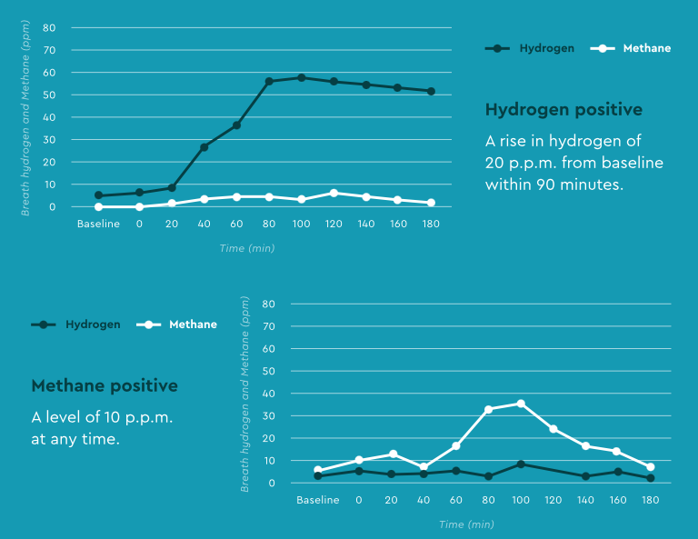
Small intestinal bacterial overgrowth (SIBO)

Slide 91
Small intestinal bacterial overgrowth (SIBO)
Treatment first includes correcting anatomy if possible (such as dilated a stricture)
The goal of therapy is to reduce but not completely eradicate the burden of bacteria to achieve symptomatic improvement
7-10 days of Rifaximin therapy is usually the first line
Other antibiotics such as metronidazole have been used
Probiotics are not recommended (conflicting evidence)

Slide 92
Treatment of diarrhea

Slide 93
Treatment of diarrhea
The most important therapy for diarrhea is to ensure that any fluid and electrolyte deficits are repaired
Most sports drinks (e.g., Gatorade) are designed to replenish fluid and electrolyte losses from exercise (mostly free water and the limited sodium chloride losses in sweat); they do not have enough sodium to replace stool losses in diarrhea effectively
Solutions that more closely approximate World Health Organization rehydration solution are now commercially available (e.g., Rehydralyte, Ceralyte, Pedialyte), typically used in acute diarrhea rather than chronic when volume depletion is a concern

Slide 94
Empirical therapy for chronic diarrhea
Empirical therapy is used in patients with chronic diarrhea in three situations
Temporizing or initial treatment before diagnostic testing
After diagnostic testing has failed to confirm a diagnosis
When a diagnosis has been made, but no specific treatment is available
Therapeutic trials of bile acid-binding resins in secretory diarrhea and pancreatic enzyme replacement in unexplained steatorrhea have been used previously
Finally, symptomatic treatment with opiates and other agents often is necessary after evaluation in patients with chronic diarrhea, since specific treatment may not be available

Slide 95
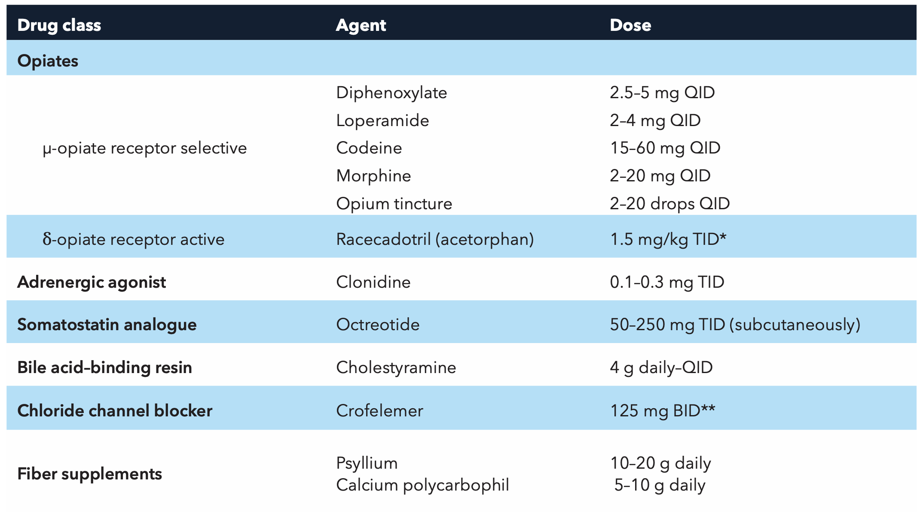
Nonspecific antidiarrheal agents

Slide 96
Take-home points
Normal bowel movements once/3days -> 3 times/day
Chronic diarrhea > 4-week duration
Fecal osmotic gap is a great tool
  Osmotic diarrhea-> simple differential
  Secretory diarrhea -> wide differential
Taking a thorough history is the most important step in figuring out chronic diarrhea etiology
Don’t forget a DRE during physical exam
Escalate appropriately in terms of tests, imaging, and scopes
Extra-intestinal manifestations and related conditions might be the only clue to the diagnosis (i.e. celiac, AIE, amyloidosis, etc.
Sometimes empiric therapy (i.e. exocrine pancreatic insufficiency) can be diagnostic

Slide 97
Thank you
Questions?
Thanks to Dr. Ferstenberg for supervising the talk

